Slide 1

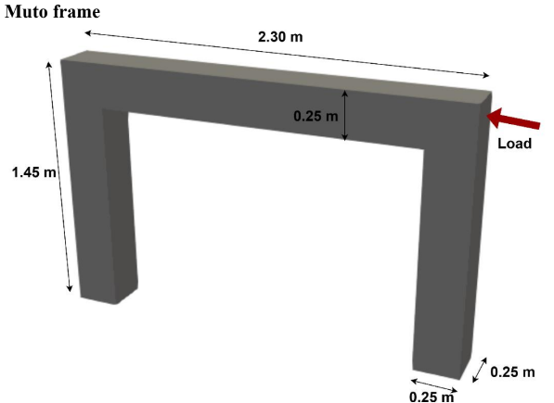


TETRAHEDRAL ELEMENT
MUTO FRAME
Monotonic load of 4% at the top of the frame

Slide 2





Work Distribution
WEIJIE LIM
SABITA DHAMI
ZWE YAN NAING
ST 124321
ST 124476
ST 124079
MATLAB , Derivation
MATLAB , Derivation
MATLAB
RAVISARA SUKAPIWAT
SURAPOL BOOTSRIPOOM
ST 123857
ST 123895
GMSH , Derivation, MATLAB
MATLAB , Derivation

Slide 3

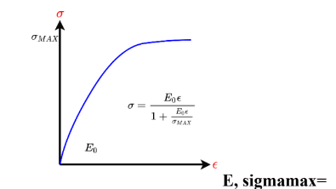
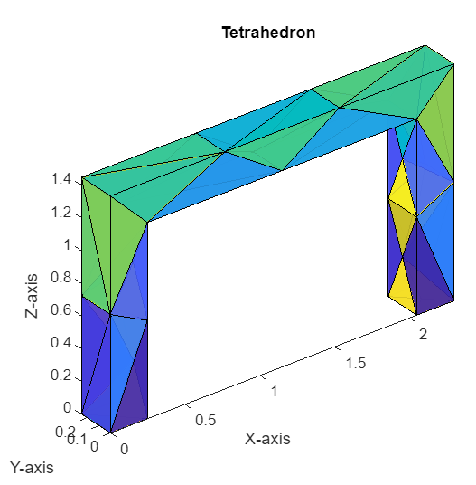
Model&GMSH
Material property
concrete
Density : 2,400 kg/m3
stress max : 20*10^6 Pa
initial tangent modulus : 22.36*10^9 Pa
poisson ratio = 0.2
number of node : 36
number of element : 57

Slide 4
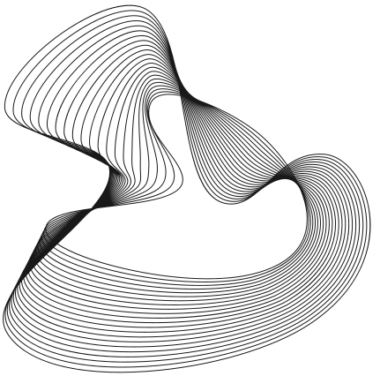
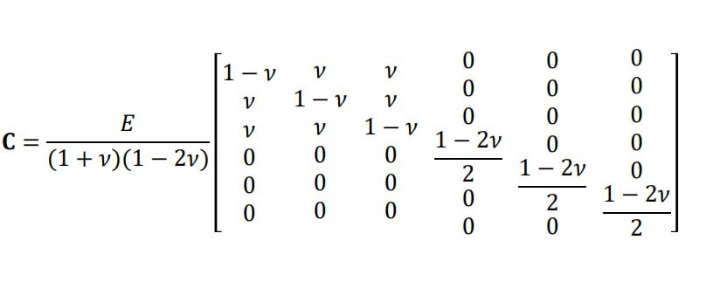
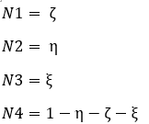
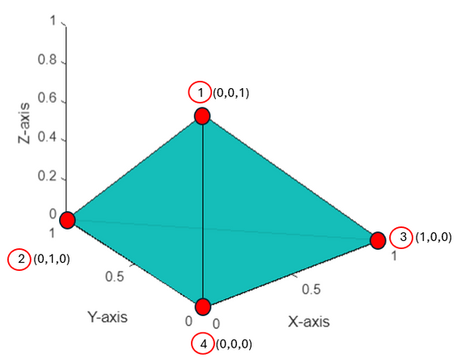
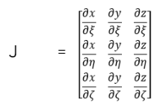
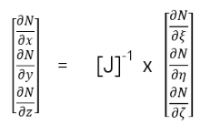
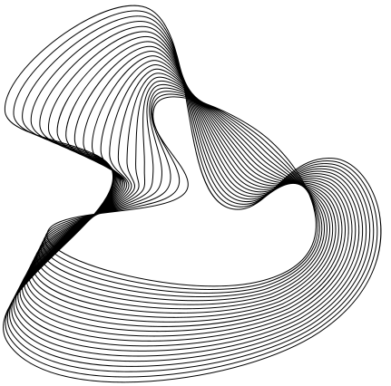
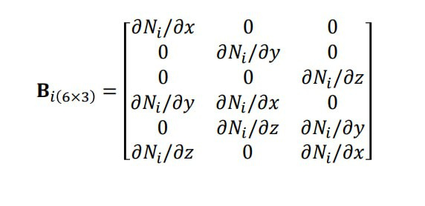
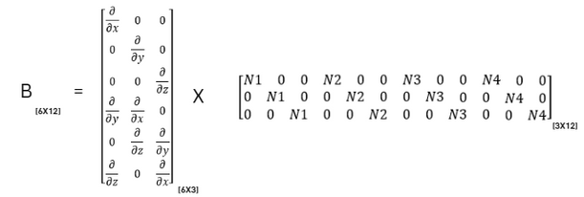
Derivations&Equations for Element
Shape function
C and B matrix

Slide 5
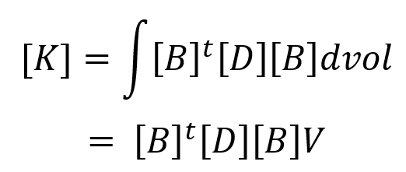

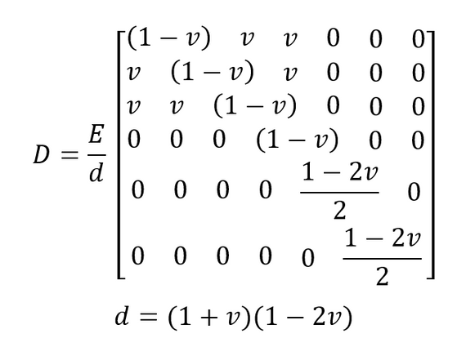
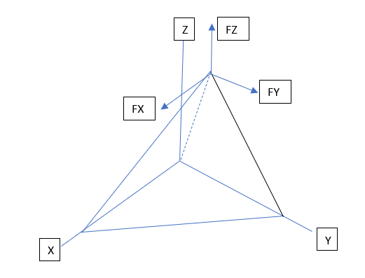
Derivations&Equations for Element
Stiffness
Traction force
where V is the volume of the tetrahedral element.

Slide 6
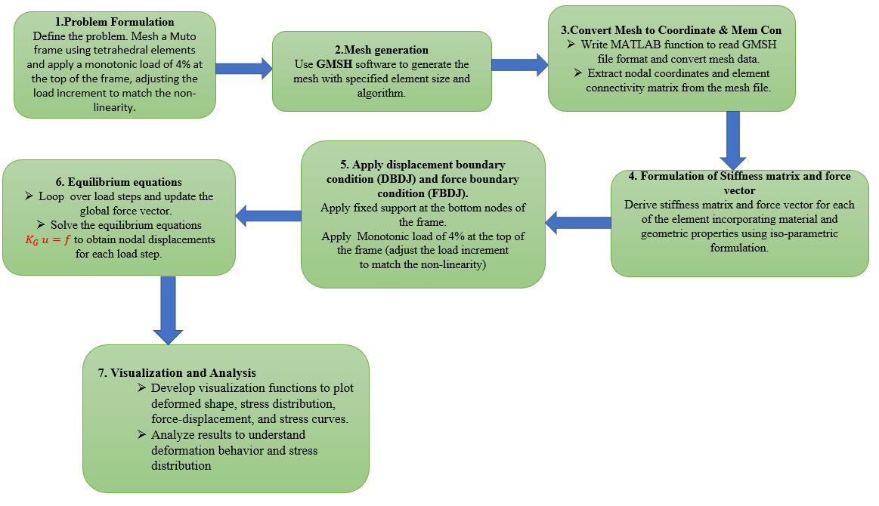

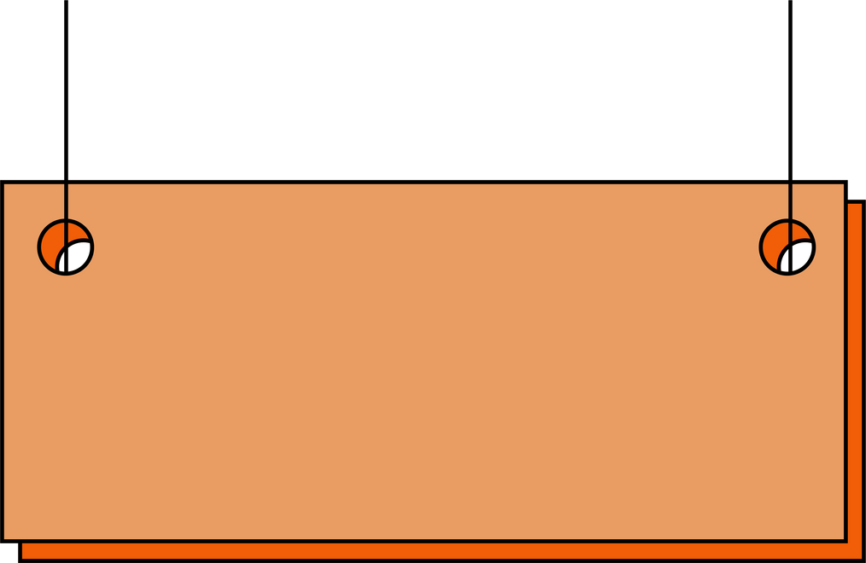
Pure-Incremental method

Slide 7

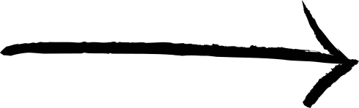
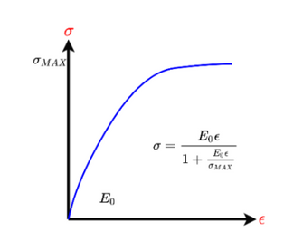
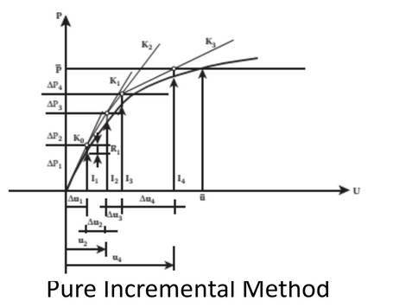

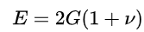
Non-linear Solution Algorithm:
Pure-Incremental method
We performed no. of iterations to obtain the force that produces displacement=0.058m
solver was applied in number of load steps
Reduced E was obtained in each incremental load step
uDisp= uDisp + KG\f_trac;
strains, stresses are obtained
Stress-strain curve-Hardin-Drenvich concrete model
Young's modulus(E) predicts how much a material sample extends under tension or shortens under compression. The Young's modulus directly applies to cases of uniaxial stress; that is, tensile or compressive stress in one direction and no stress in the other directions.
In 3D FEM, there is shear stress between the each other elements.
Describes behavior of a material under different loading
conditions (tension, compression, shear)
E
G

Slide 8

Solver for non-linearity
Step 1
Find
Strain
[Not same in each direction]
Find
Stress &
E each direction for next step
From HD model
Adjust
the D matrix
For next step
use E0
udisp = KG/F
Go to
next step

Slide 9
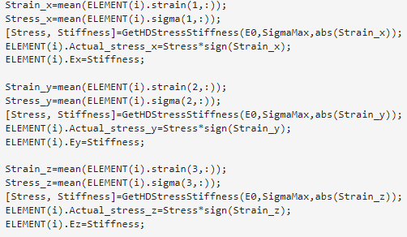
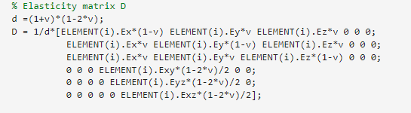
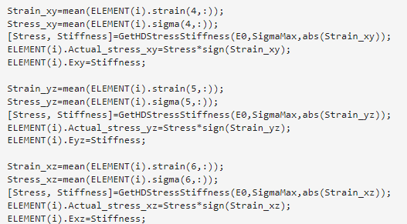
Solver

Slide 10
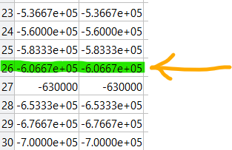
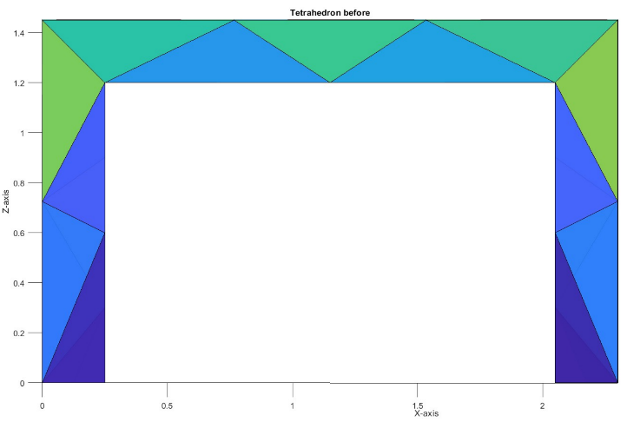
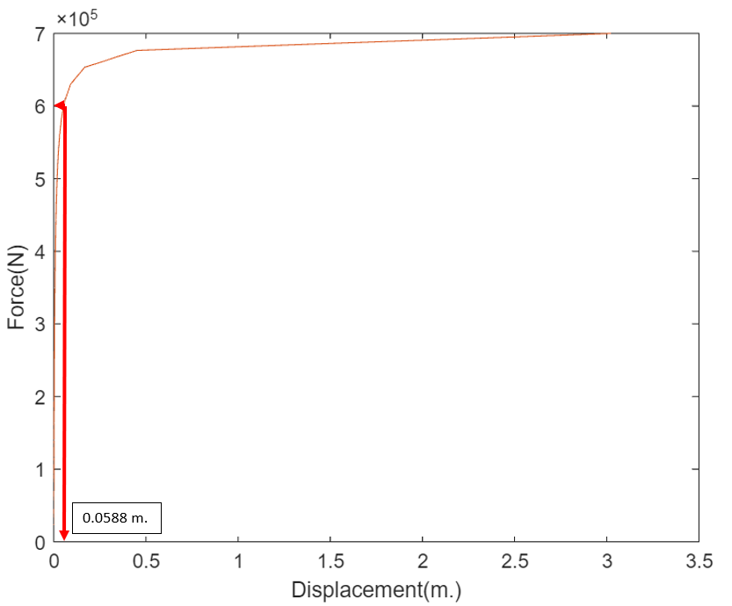
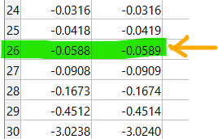
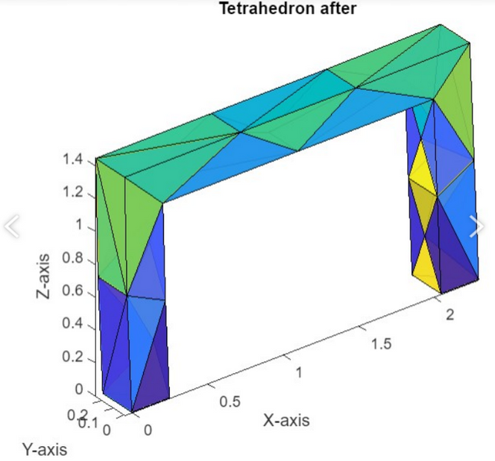

Result& Analysis
The total load applied is 1.21 x 10^6 N to get the desired displacement at force step 26
the corresponding load for each two nodes is 6.07 x 10^5 N.
Force-Displacment relationship
the displacement at 4% is around 5.89 cm.

Slide 11
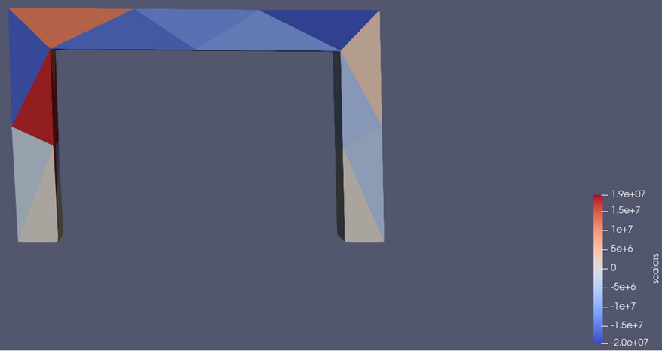
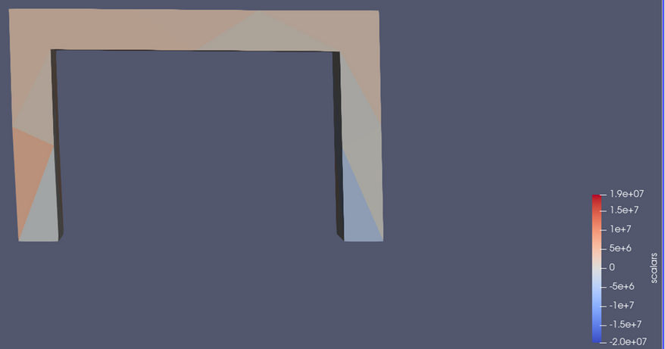
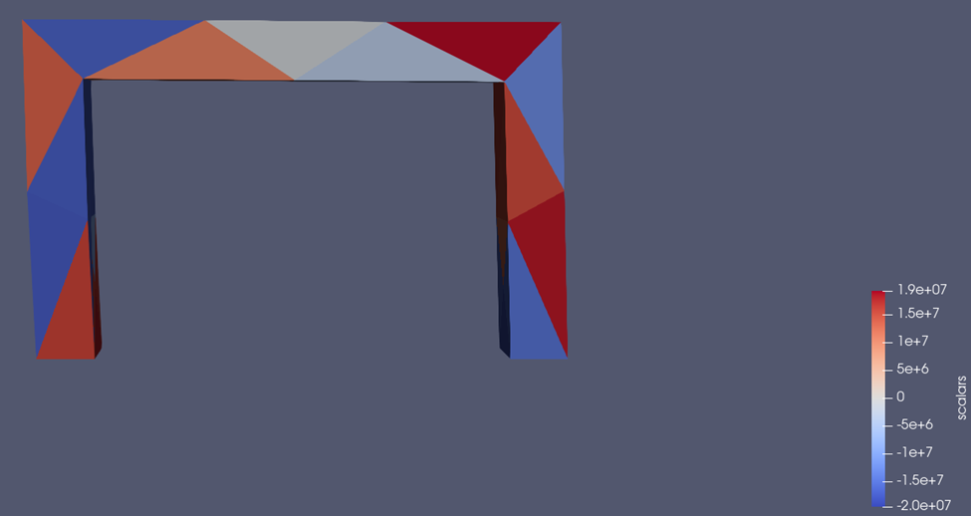
Result& Analysis
Stress X direction
Stress Y direction
Stress Z direction

Slide 12
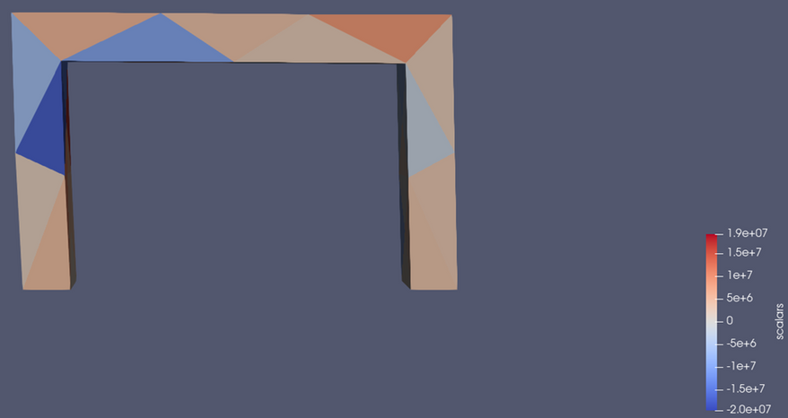
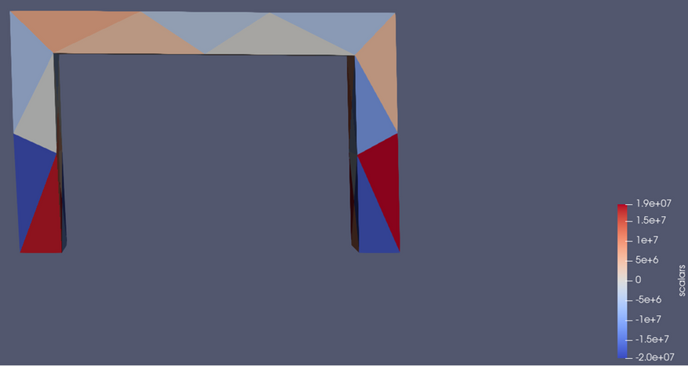
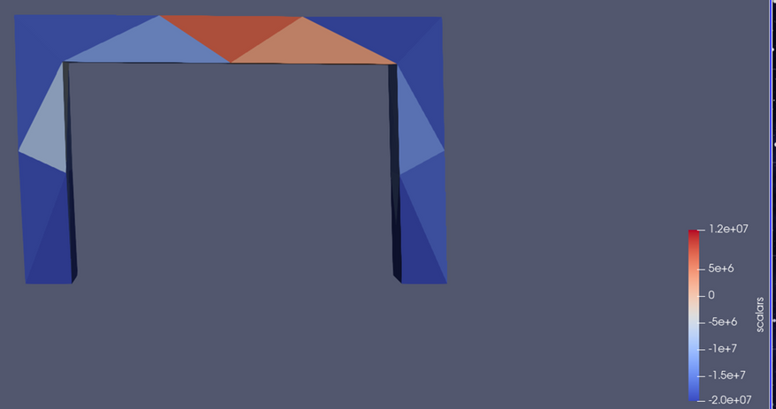
Result& Analysis
Stress XY direction
Stress YZ direction
Stress XZ direction

Slide 13
Observations
When we increase the number of step, the load that get displacement equal to 0.058 will decrese.
it is observed that the strain of element in each directions does not deform uniaxially (in same magnitude) even isotropic material is assumed in this case.

Slide 14
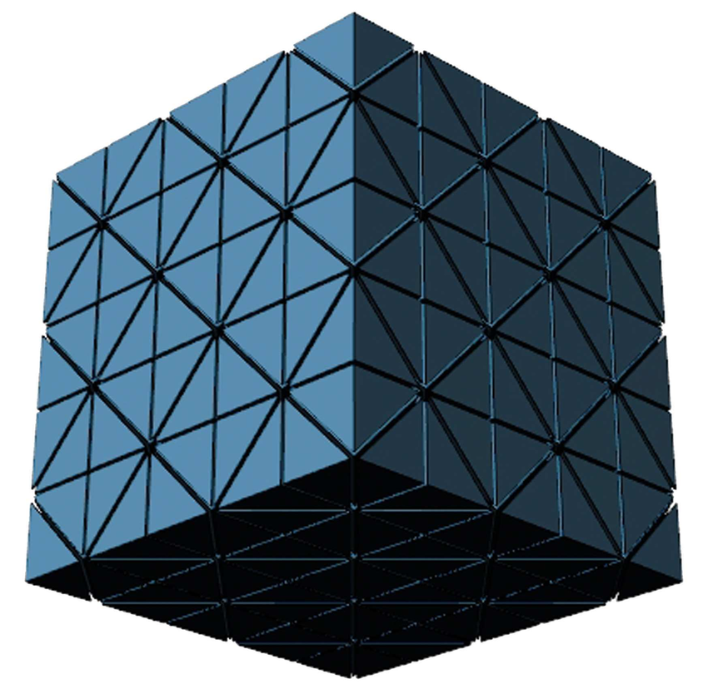
Program Utilization
-use for isotropic material
-for simple regular structure
-for non-linearity

Slide 15
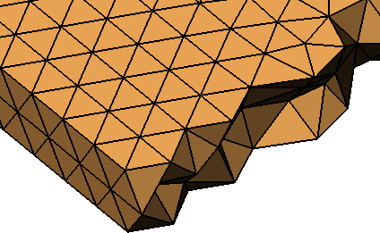
Thank You

